Slide 1

Bird Strikes in Aviation: Simple Data Insights for Safer Flights
Making air travel safer through real collision data analysis from 2000-2011

Slide 2

Project Overview: Understanding the Challenge
Our Goal
Key Focus Areas
Analyse bird collision data to improve flight safety and reduce operational costs
Safety protocols and operational impacts
Wildlife management strategies
Data Source
Cost reduction opportunities
Comprehensive reports of bird strikes spanning 2000-2011
Risk mitigation and regulatory compliance
Pilot awareness and training enhancements

Slide 3
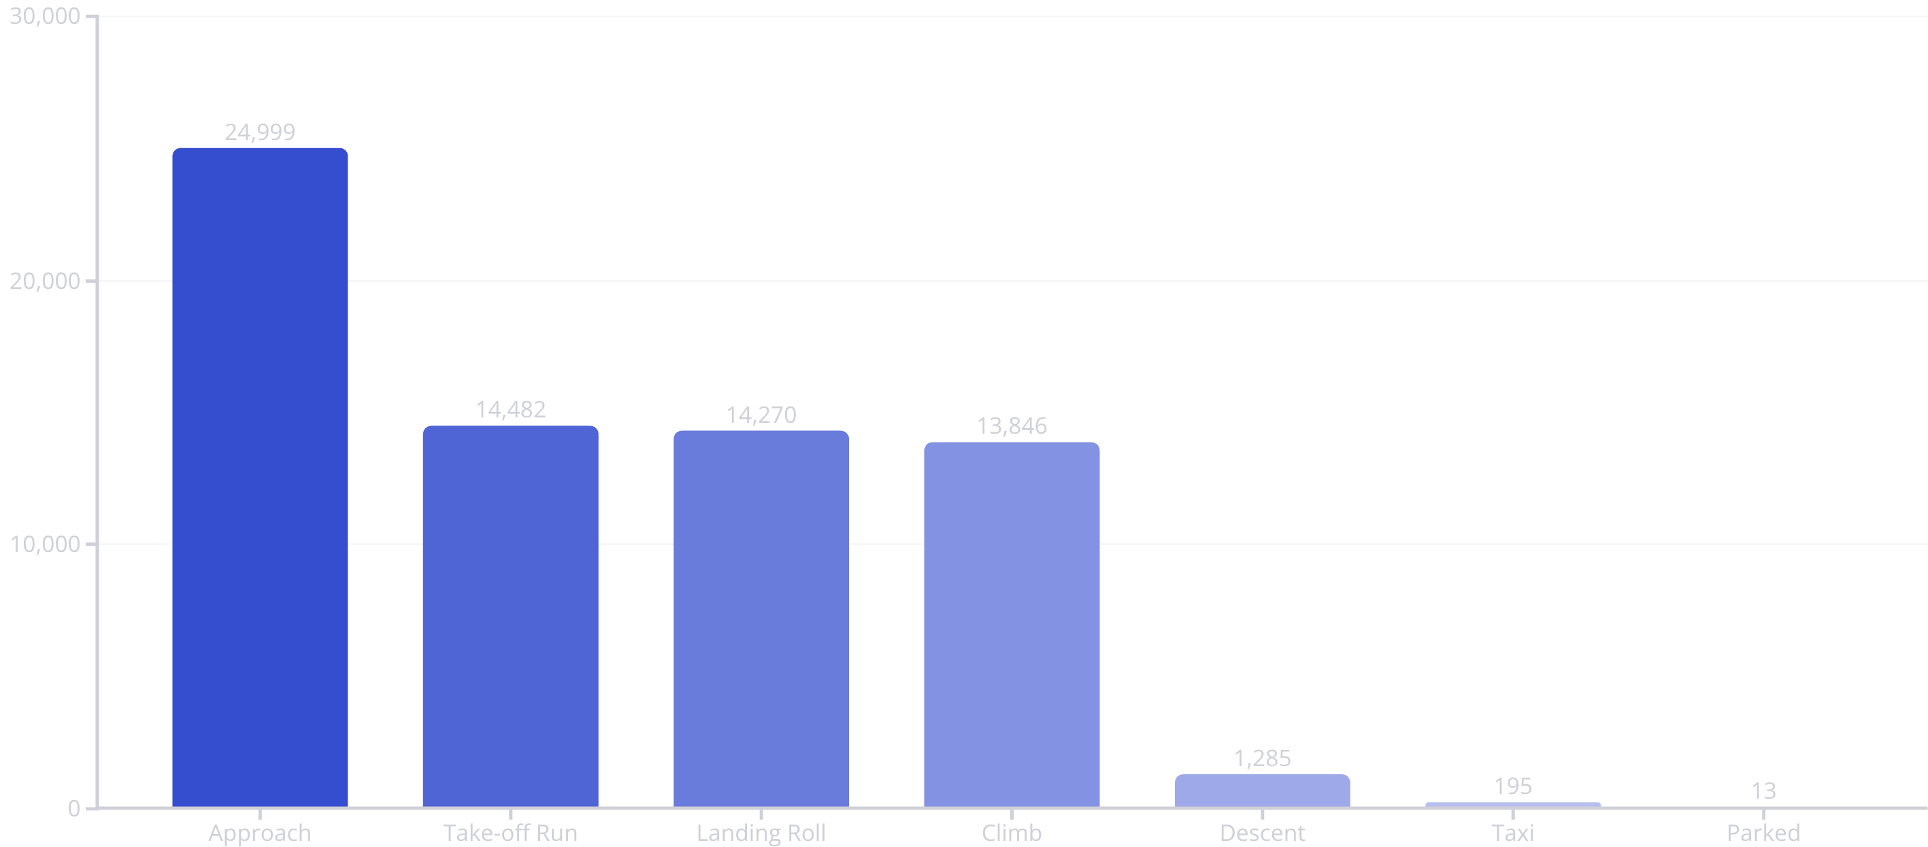
When Bird Strikes Happen Most
Critical flight phases and aircraft vulnerability patterns
Critical Insight
Aircraft Most Affected
Most strikes occur during approach and take-off—when aircraft are closest to ground level
B-737 series and A-320 family experience highest strike rates

Slide 4
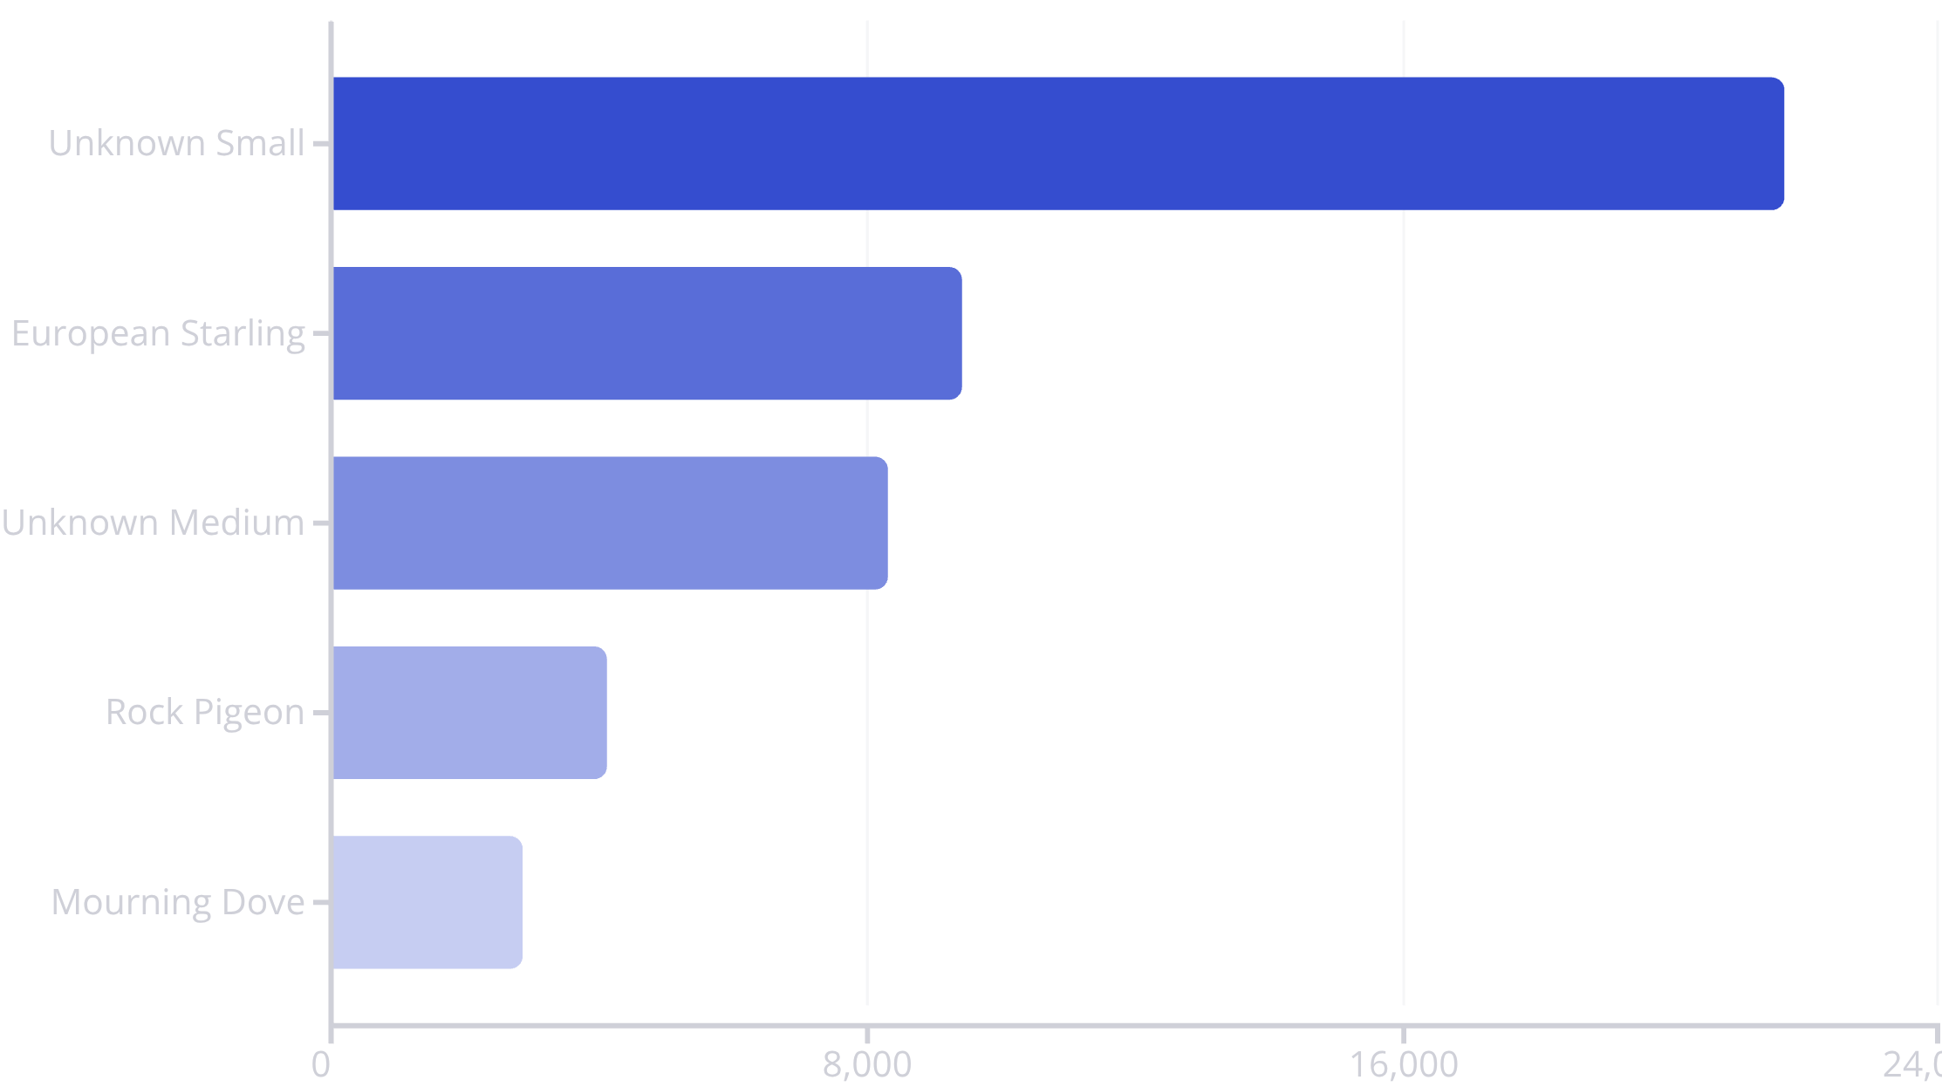
Birds Involved: Wildlife Patterns
Common Outcome
Wildlife Challenge
Precautionary Landing: 63,078 incidents
Small, unidentified birds account for majority of strikes
Most strikes lead to safe inspections rather than emergencies
Starlings and pigeons are most frequently identified species

Slide 5
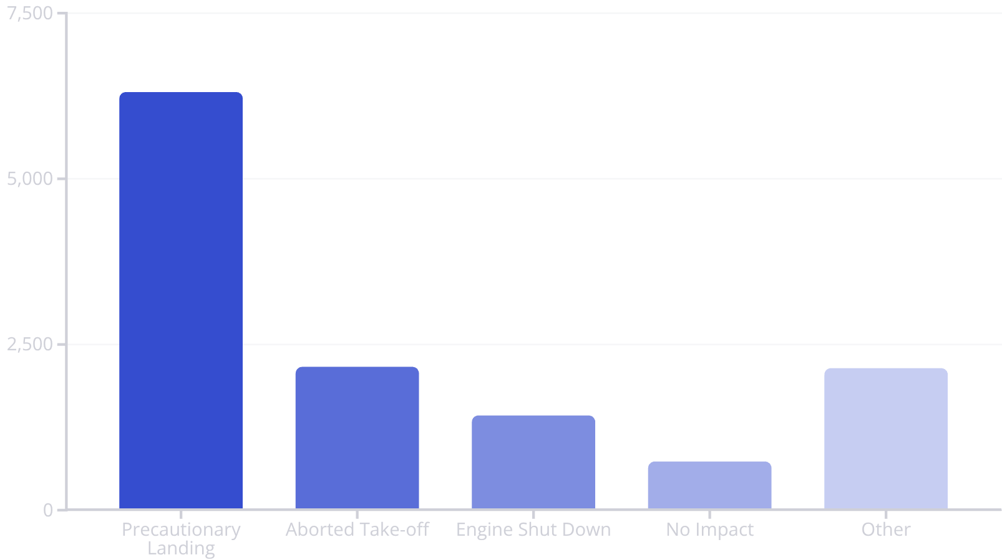
Operational Impact: Flight Disruptions
Key Takeaway
Majority of strikes cause minimal disruption to flight operations
However, serious incidents require immediate response protocols
01
02
03
California: 8,527 strikes
Texas: 6,051 strikes
Florida: 4,087 strikes
04
05
Pennsylvania: 3,528
High-traffic regions experience elevated strike frequency

Slide 6
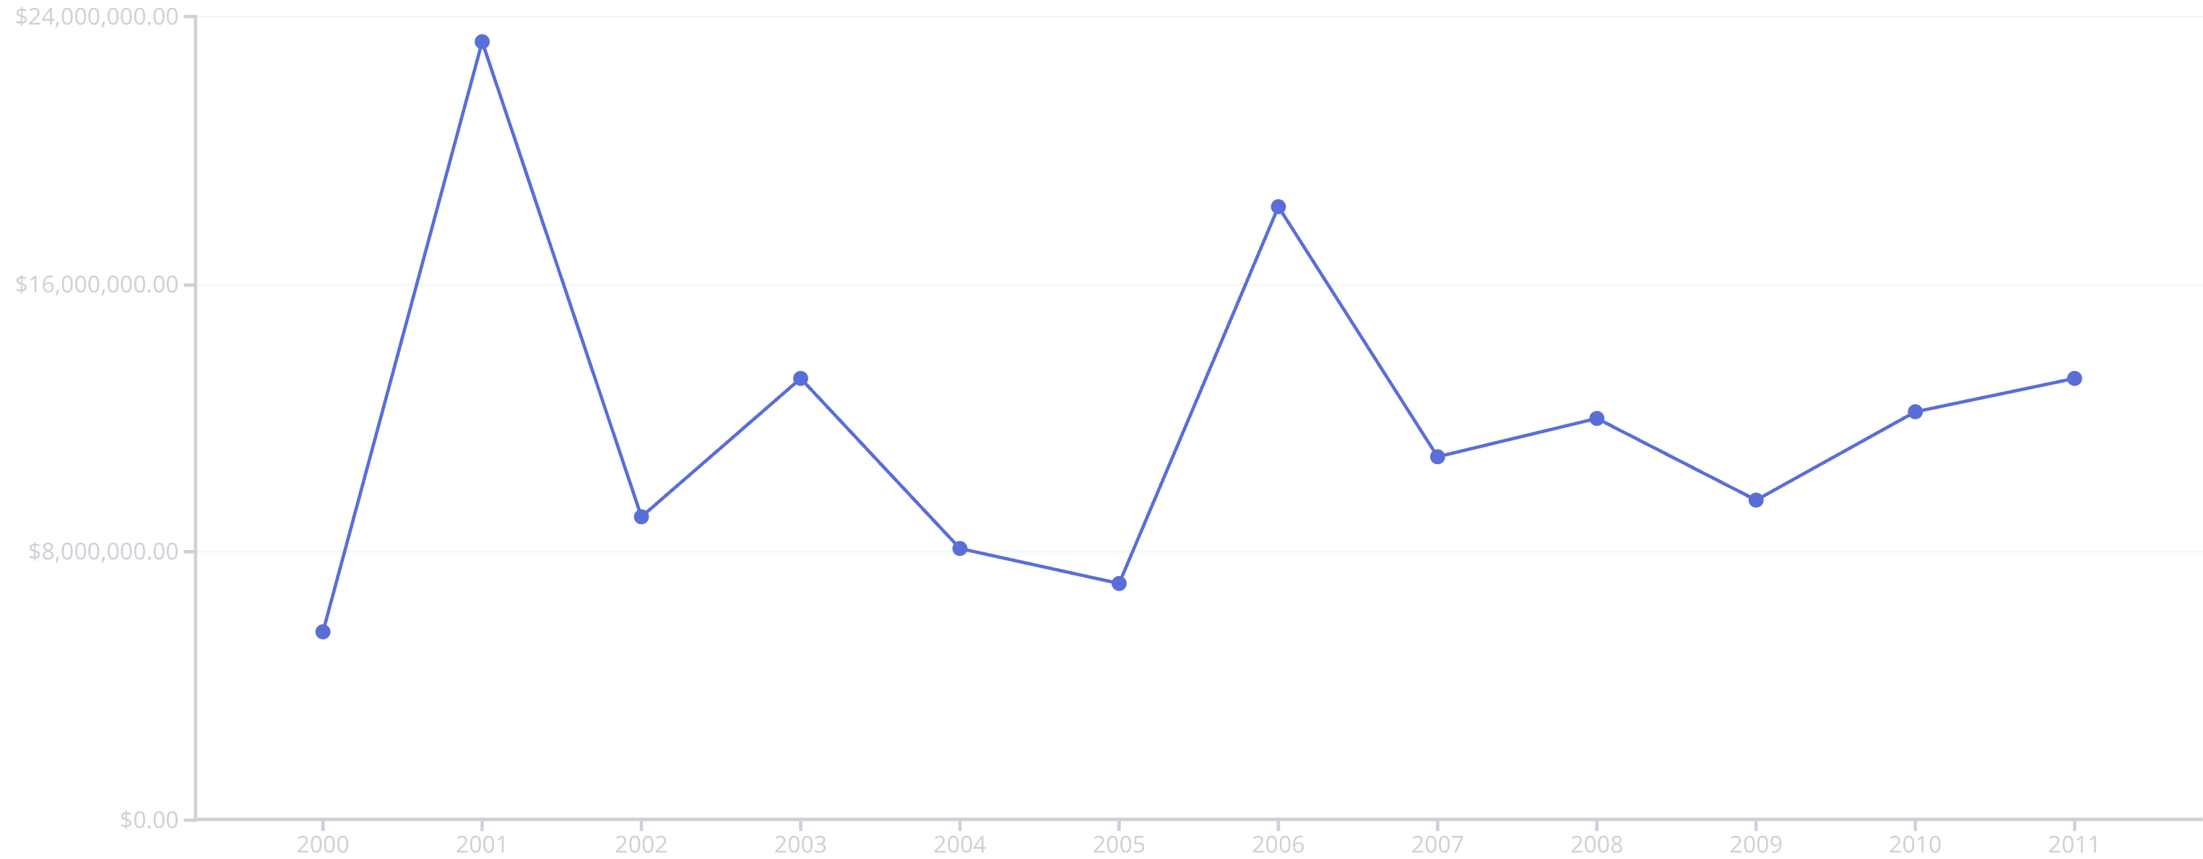
Financial Impact: The Cost of Bird Strikes
Annual repair and operational expenses reveal significant economic burden
$54M
$12M
$8M
$23M
Business Aviation
United Airlines
Delta Airlines
Peak Year: 2001
Highest repair costs
Major carrier expenses
Strike-related costs
Highest annual cost

Slide 7
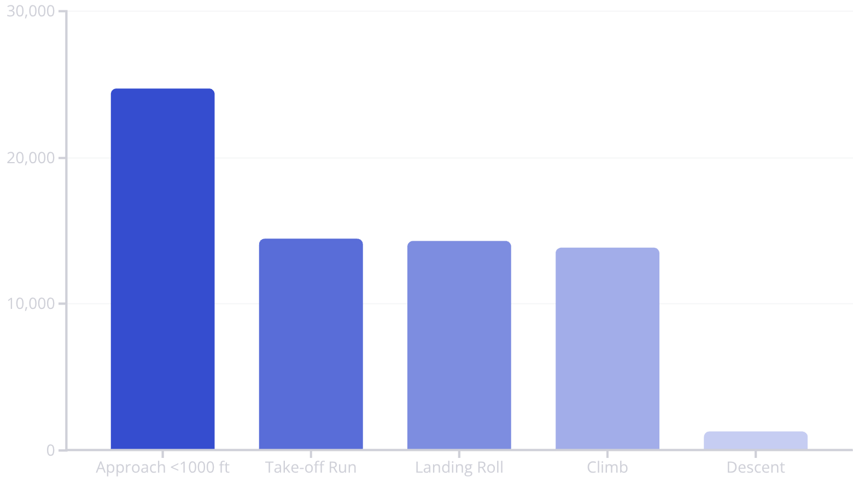


Risk Analysis: Altitude and Flight Phase
Strikes by Altitude
Mitigation Success Rates
Approach
Landing Roll
Take-off Run
Climb
Descent
Critical Finding: Greatest risk exists below 1,000 feet during approach and landing phases. Prevention measures show highest effectiveness during these critical moments.

Slide 8



Reporting Trends and Weather Conditions
47%
33%
20%
Clear Skies
Partial Cloud
Overcast
No cloud cover during strikes
Some cloud conditions
Full cloud coverage
Reporting Improvement
Weather Pattern Insight
Strike documentation has steadily increased from 2000 to 2011
Majority of bird strikes occur during clear weather conditions when both aircraft and bird activity are highest
Enhanced compliance with safety protocols
Good visibility does not eliminate risk—active management remains essential

Slide 9


Pilot Awareness: Warning Systems Evolution
1
Early Period (2000-2005)
Limited warning systems, lower pilot awareness
2
Transition (2006-2009)
Gradual implementation of bird alert technologies
3
Modern Era (2010-2011)
Significant increase in pre-flight bird warnings issued
Approach Phase
Landing Roll
Warnings: 4,003 | No Warnings: 6,305
Warnings: 2,844 | No Warnings: 2,092
Take-off Run
Climb Phase
Warnings: 2,615 | No Warnings: 2,168
Warnings: 1,436 | No Warnings: 2,905
Warning systems demonstrate greatest effectiveness during take-off and landing phases, improving pilot response times and safety outcomes.

Slide 10
Practical Solutions for Safer Skies
Advanced Detection
Habitat Management
Deploy bird radar systems at high-traffic airports to provide real-time avian activity monitoring
Clear bird-attracting areas near runways through systematic vegetation and waste control
Enhanced Warnings
Post-Strike Protocols
Improve pilot alert systems for high-risk locations and critical flight phases
Conduct thorough aircraft inspections after every reported bird strike incident
Pilot Training
Data Sharing
Enhance detection and avoidance skills through specialised bird strike awareness programmes
Foster cross-team communication to disseminate strike patterns and prevention strategies
Key Insight
Cost Focus
Most strikes occur during approach and landing at low altitudes—concentrate prevention efforts on these critical phases
Target high-expense species and busy airports to maximise return on safety investments

